Slide 1


Stock Market Simulator
Group Project from OOP
Narek Lazyan, Ani Saroyan, Suren Norekyan
Group 32

Slide 2
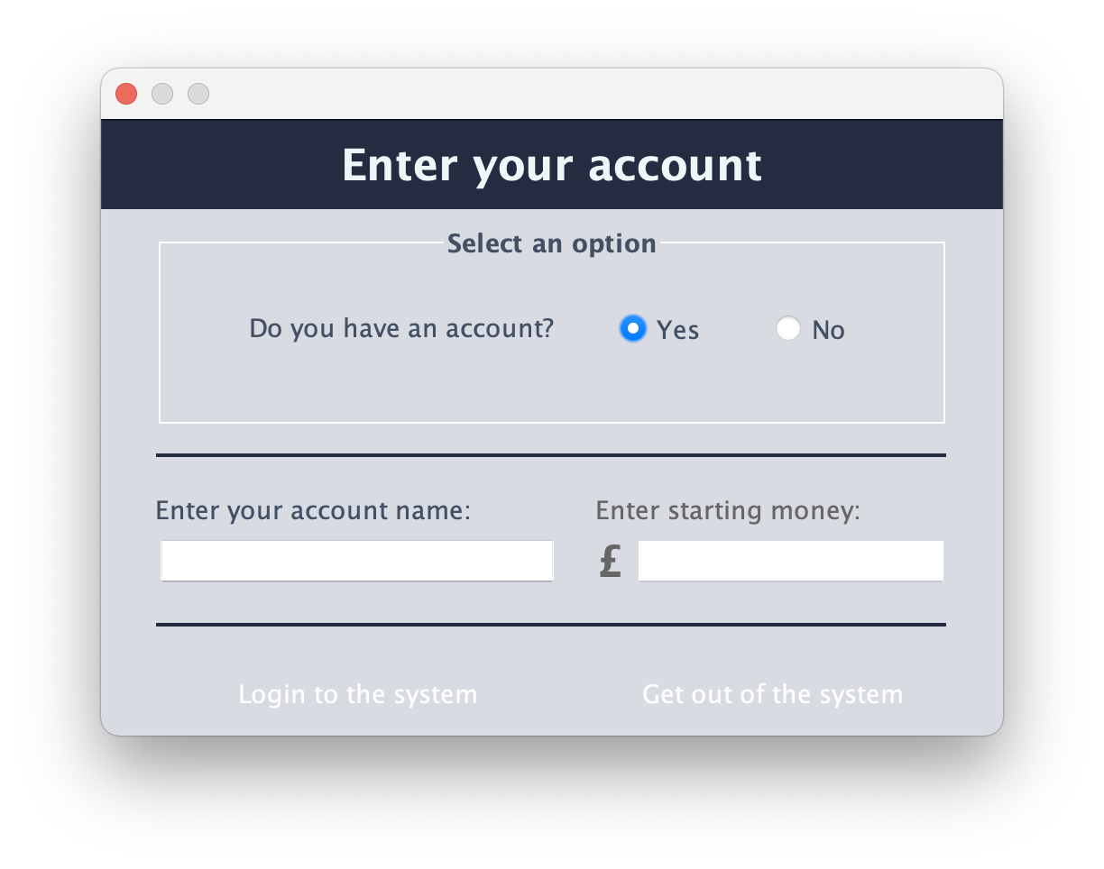
Account registration

Slide 3
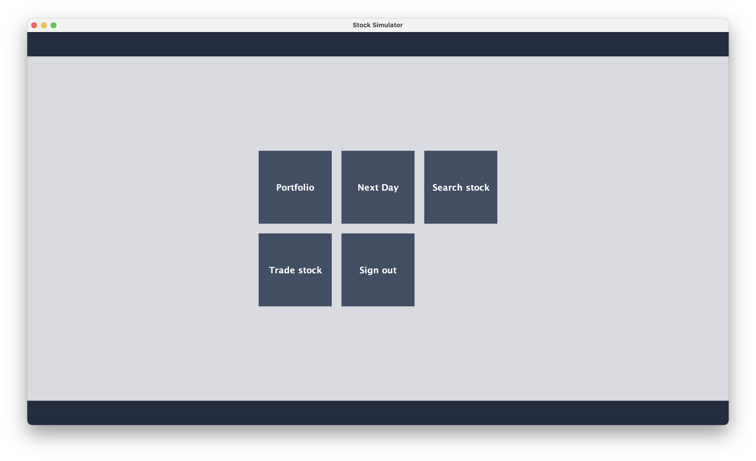
Main Program

Slide 4
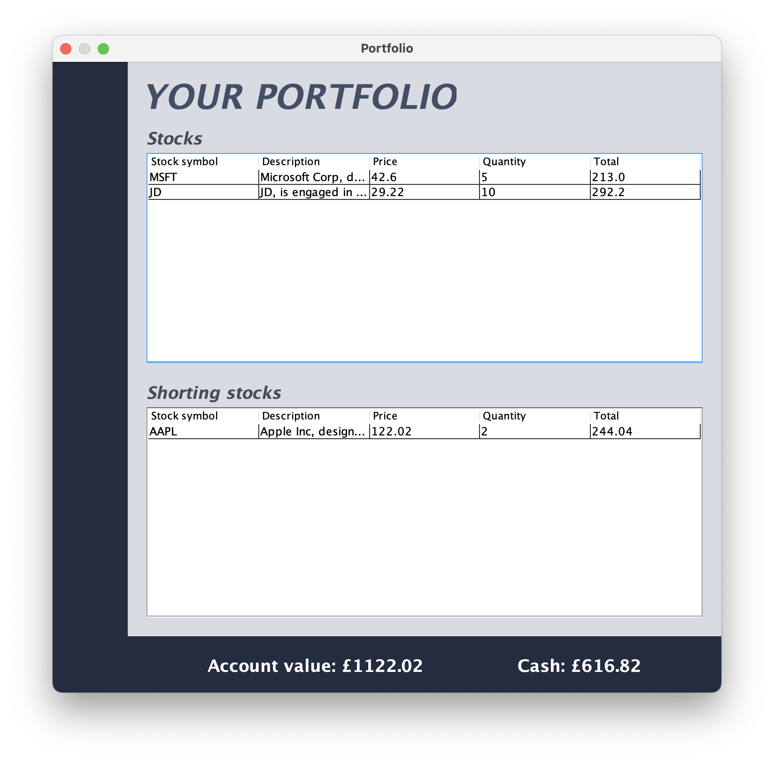
Portfolio window

Slide 5
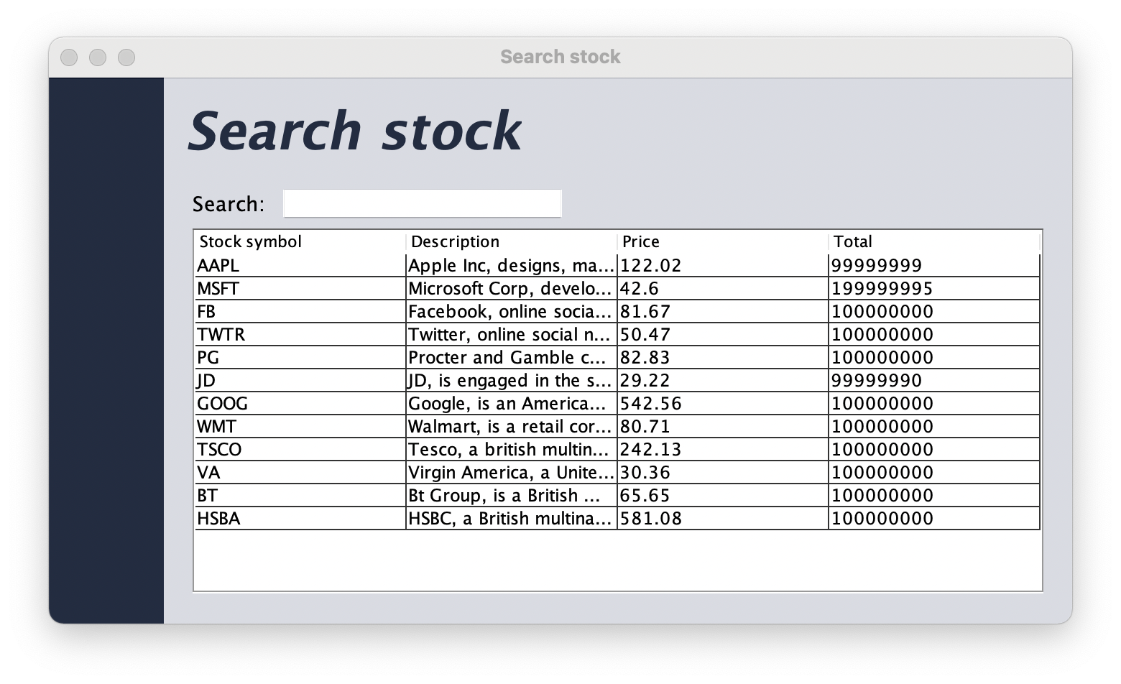
Searching Stocks

Slide 6
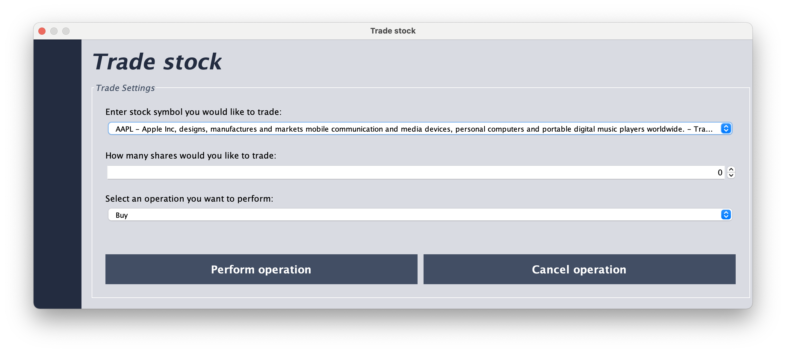
Trade window

Slide 7
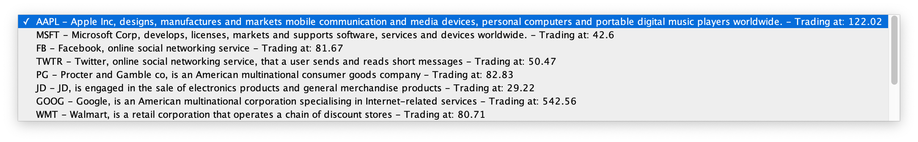
Trade window

Slide 8

Next Day and Sign out options
Updates stock prices
Signs out of your account and returns to main page

Slide 9
UML
Diagram

